Slide 1
Middleware in DC
Chap 1 (Continued)

Slide 2
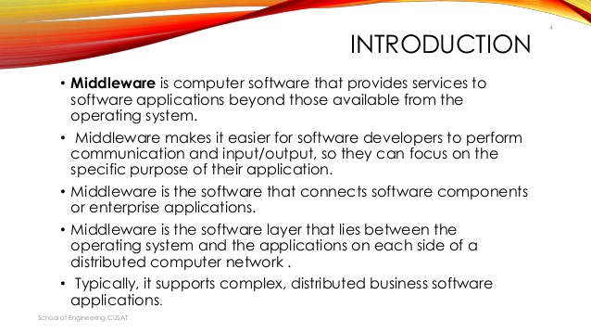

Slide 3
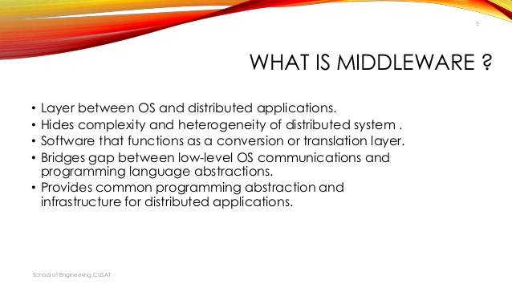

Slide 4
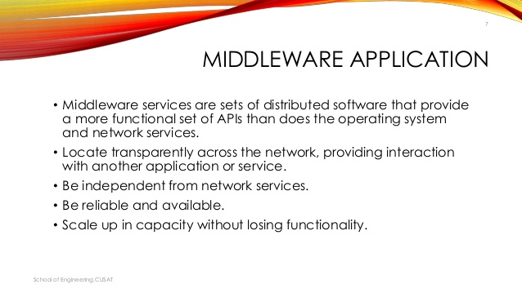

Slide 5
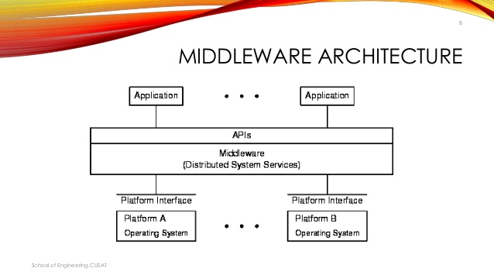

Slide 6
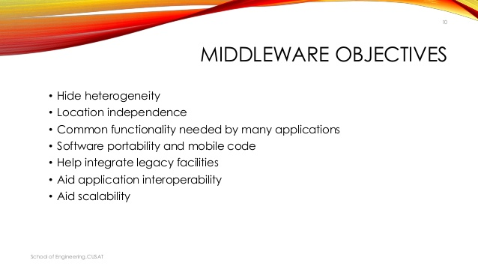

Slide 7
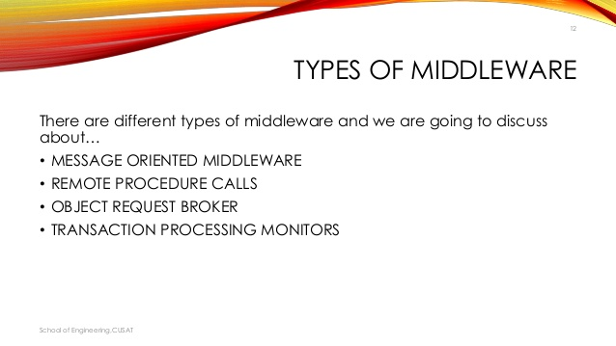

Slide 8
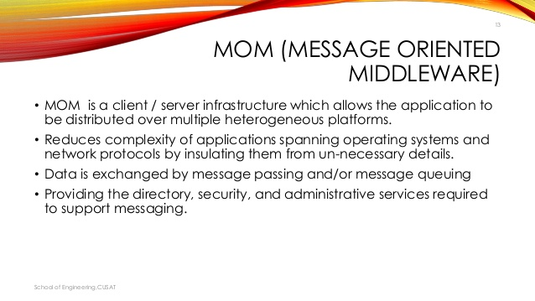

Slide 9
MOM is a type of middleware that uses messages as the method of integration.
In MOM the applications are decoupled. i.e Sender and receivers are never aware of each other; instead they send and receive the messages from the messaging system. It is the responsibility of the MOM to get the messages to their destinations.
The messaging system uses channels that the applications can recognize and the messages can be sent and received asynchronously.
The asynchronous paradigm allows the application to continue functioning after sending a request, so if the message is taking too much time it is possible to process other messages while is waiting, they can deal with down connections and queue messages until it’s viable to deliver them

Slide 10
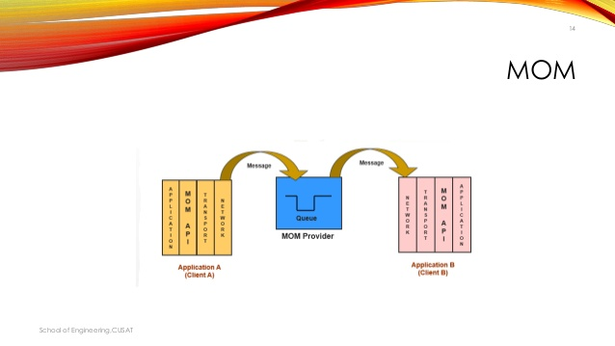
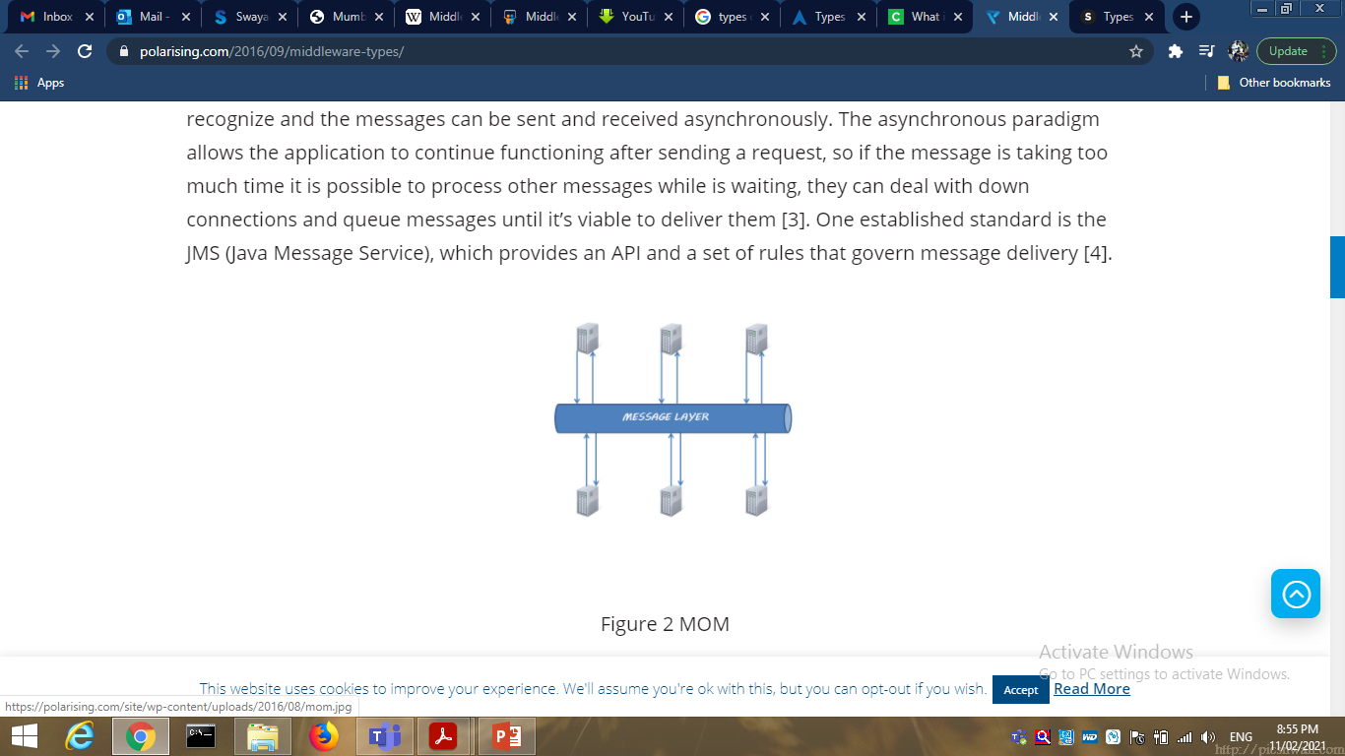

Slide 11
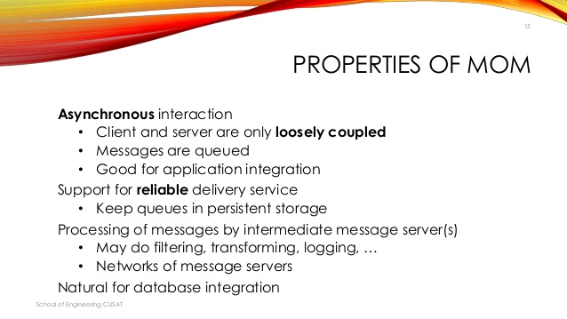

Slide 12
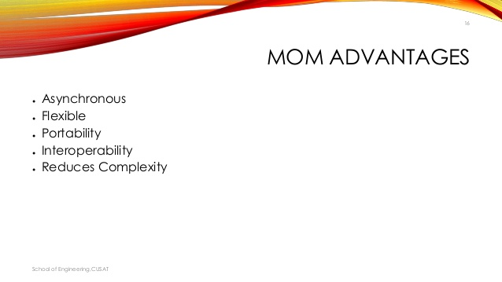

Slide 13
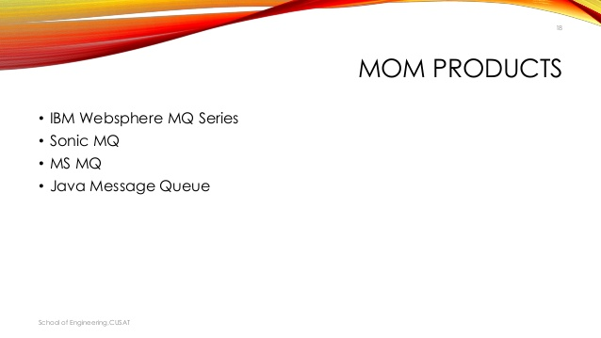

Slide 14
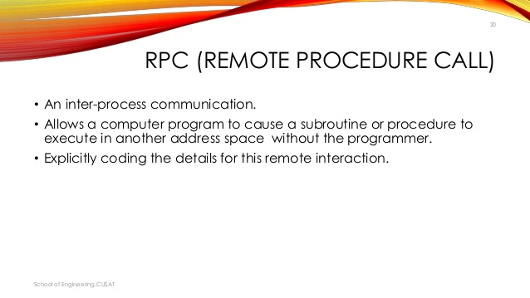

Slide 15
RPC exists since the 1970s and are the oldest type of middleware and it is client/server based.
One client can request a service from a program located in another computer in a network without having to understand network details.
RPCs are synchronous; the requesting program is suspended until the results of the remote procedure are returned. As the RPC’s use a point-to-point communication, they are not scalable and consume a vast amount of resources during they processing.
Despite the simplicity, the complexity of their maintenance and performance issues, make this middleware not a viable solution in scenarios where there are many applications requiring integration.

Slide 16
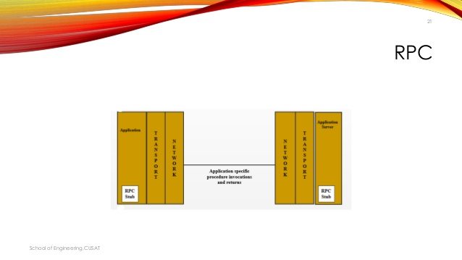
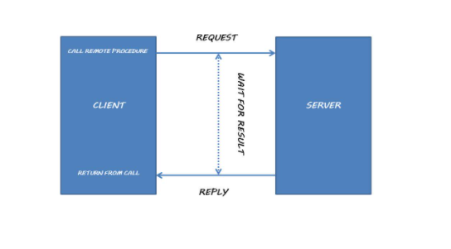

Slide 17
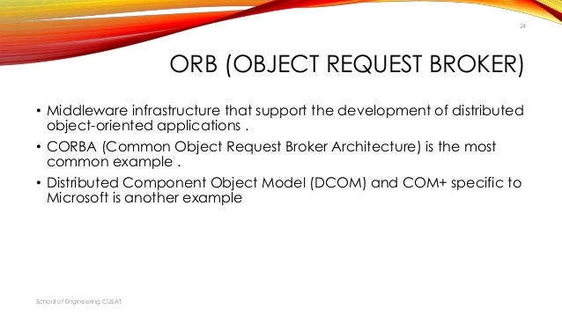

Slide 18
The role of ORB is to control the communication between objects in distributed computing.
ORB are small applications that use standard interfaces and protocols to communicate with one another.
Because they are built over standards, two compliant objects should be able to exchange information and carry out application functions by invoking each other methods.
ORB allows an object to request services from other object without having to learn his location in a distributed network using the CORBA Interface repository to locate and communicate with a requested object.

Slide 19
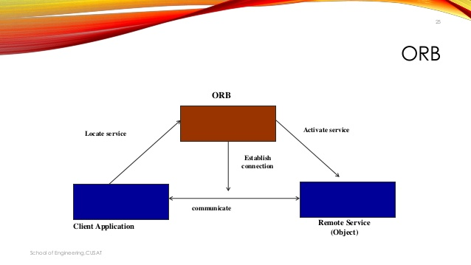
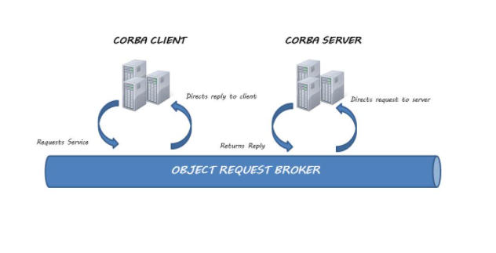

Slide 20
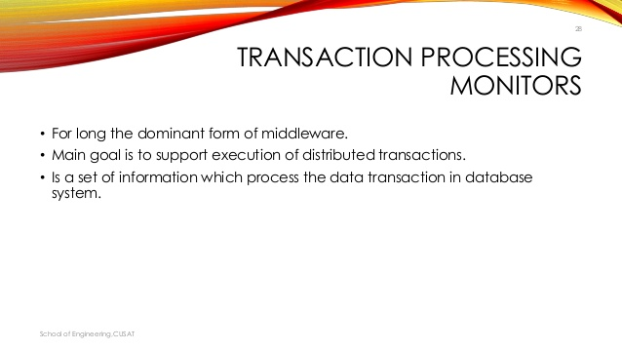
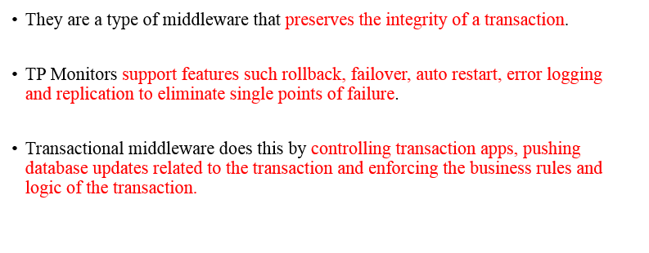

Slide 21
